Slide 1
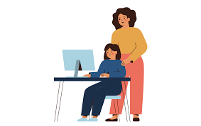
UNDERSTANDING SAFE ONLINE COMMUNICATION

Slide 2
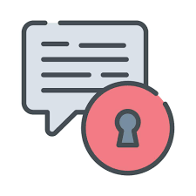
Safe online communication is all about protecting your privacy and personal information while interacting with others online. In India, the digital environment is rapidly evolving, so it is essential to be aware of the tools and best practices that keep you safe.

Slide 3
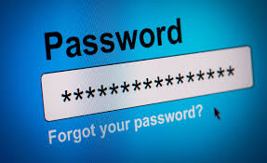
STRONG PASSWORDS
Passwords: Use unique and complex passwords for every online account. A strong password includes:
A mix of upper and lower case letters, numbers, and symbols.
Avoid using names, dates, or easily guessable combinations.

Slide 4
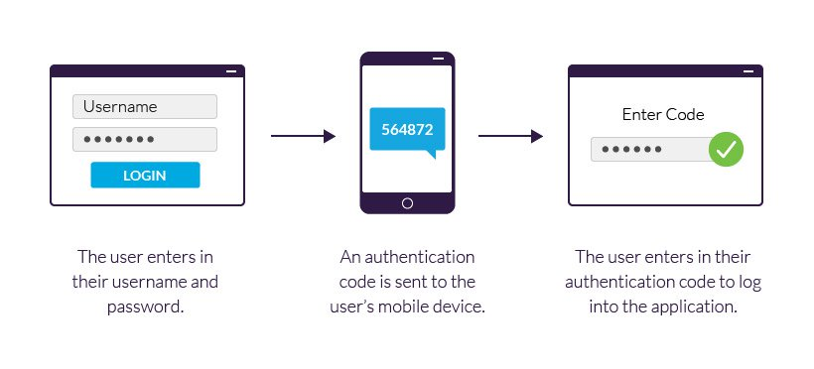
2 FACTOR AUTHENTICATION
Enable 2FA on services like Gmail, WhatsApp, and Facebook. This adds an extra layer of security by asking for a second form of verification, like a one-time password (OTP) sent to your mobile number.

Slide 5

PHISHING AND SCAM AWARENESS
Phishing is a deceptive practice where fraudsters impersonate legitimate institutions (banks, government agencies, etc.) to steal sensitive information like usernames, passwords, or credit card details.

Slide 6
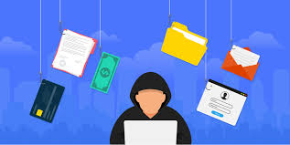
RED FLAGS
Suspicious messages from unknown sources or asking for urgent action.
Emails or SMS messages with fake links that resemble legitimate websites (e.g., "hxxps://www.y0urbank.co.in").
Requests for personal details (passwords, Aadhar numbers, bank account information).
Always verify the authenticity of any unsolicited communication by contacting the institution directly using official phone numbers or email addresses.

Slide 7

SECURE WEBSITES AND PUBLIC WIFI SAFETY
HTTPS indicates that a website is secure. When accessing sensitive sites (e.g., online banking, shopping), ensure the URL starts with HTTPS (the "S" stands for Secure). You will also see a padlock symbol next to the URL.
Avoid accessing sensitive accounts (like banking or email) on public Wi-Fi networks, as these are more vulnerable to cyberattacks.
If necessary, use a VPN (Virtual Private Network) to ensure secure browsing.

Slide 8
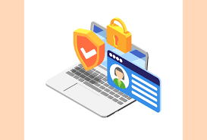
PRIVACY SETTING AND PERSONAL DATA PROTECTION
Adjust privacy settings on platforms like Facebook, Instagram, Twitter, and LinkedIn to control who can view your posts and personal details.
Be cautious when sharing personal information like phone numbers, addresses, or identification numbers (e.g., Aadhaar, PAN).

